Slide 1
AQUATIC FACILITY PLANNING
Regional Aquatic Facility Network
Partnership Approach
What do we know ?
Where? and How ?

Slide 2
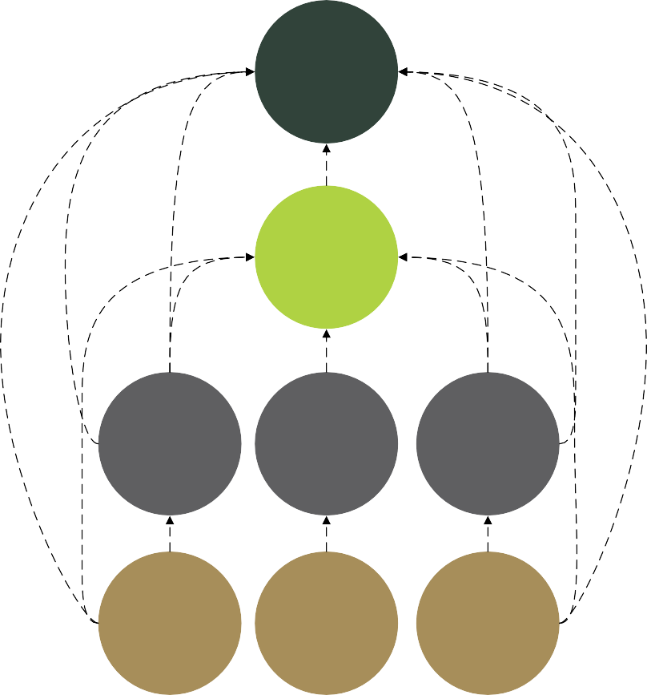
1. COMPLIMENTARY NETWORK
Interconnected network where Facilities feed into each other. Avoid duplication at the regional and district level.
National
Regional
Napier Aquatic Centre
District
Local

Slide 3
OPTIMISING THE NETWORK
1. COMPLIMENTARY NETWORK
2. FACILITY HIERARCHY
Interconnected network where Facilities feed into each other. Avoid duplication at the regional and district level.
Ensures there are facilities available in a region that can be used by a wide range of users. Helps to understand where duplication or gaps exist
National (International)
1
Regional
1
District
(sub-regional)
5
Local
(sub-district)
94
3. AFFORDABLE
4. ACCESSIBLE
5. QUALITY EXPERIENCES
Pools are affordable to encourage participation. Long term sustainability.
Pools are located to best service catchment areas including schools and residential areas.
Facilities foster quality experiences for that are inclusive – for all people

Slide 4
HAWKES BAY REGIONAL NETWORK
 |  | HASTINGS | NAPIER | CENTRAL HB | WAIROA
National (International) |  | 1
Regional |  | 1
District (sub-regional) |  | 1 | 2 | 1 | 1
Local (sub-district) | Community Indoor | 1 | 1
 | Community Outdoor | 1 |  | 1
 | School - Secondary | 7 | 2 | 1
 | School - Primary | 34 | 18 | 12 | 13

Slide 5
PARTNERSHIP APPROACH
INFORMS AND GUIDES
PROVIDES THE EXPERIENCE
National Aquatics Facility Strategy
Regional Aquatics Facility Plan
District Facility Strategy
Citizens Assembly
COMMUNITY VOICE
Feeds back and Informs

Slide 6
KEY CONCEPTS
1. How much Water Space is required
 | Benchmark per 1000 residents | Hawke’s Bay
2023 | 27m² | 43m²
2038 | 27m² | 42m²
2. Activity Type / Pool Type
Leisure
Play
Relaxation
Hydrotherapy
School recreational access
Fitness
Health
Lane Sports
Deep water sports
Aquatic Competence
Cooler water
Warmer water

Slide 7
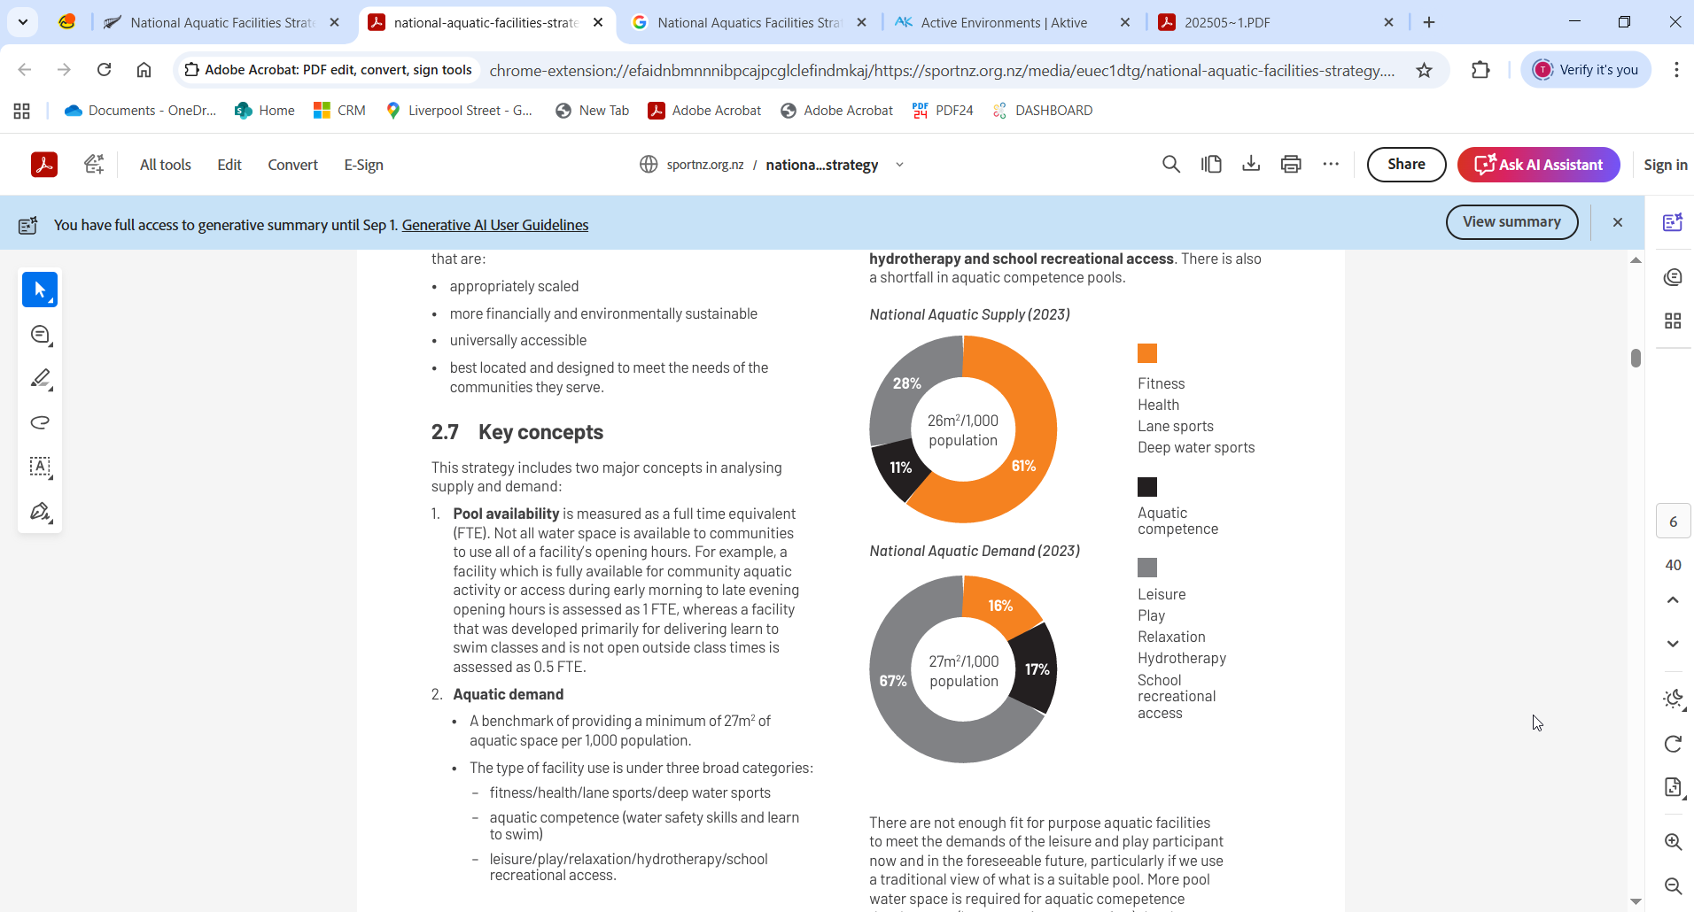
3. Supply (2023)
V
Demand (2023)
Leisure
Play
Relaxation
Hydrotherapy
School recreational access
Fitness
Health
Lane Sports
Deep water sports
Aquatic Competence

Slide 8

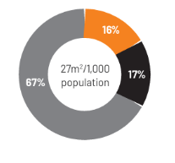
UNDERSTANDING THE IMBALANCE
FOR HAWKE’S BAY
2038 | 2038 FTE water area per 1,000 | Leisure/Play/relaxation/hydrotherapy/school recreational access | Aquatic Competence | Fitness/Health/Lane sports/Deep water sports
National benchmark | 27m² | 67% | 17% | 16%
Hawke’s Bay FTE supply | 42m² | 22% | 13% | 65%
Hawke’s Bay imbalance |  | -45% | -4% | 49%

Slide 9
Where do we want to be ?
PAGE 36
Strong authentic partnerships
Use what we already have
Sustainable development
Network approach
Co-design
Key Shifts – how do we get there ?
PAGE 37
Address the imbalance
Community provision over event facilities
Improved management approaches
Continuous improvement in planning

